Slide 1
Statistical Inference
Lab 9

Slide 2
Supervised learning
Supervised learning deals with or learns with “labeled” data. This implies that some data is already tagged with the correct answer.
Supervised learning can be separated into two types of problems when data mining—classification and regression.

Slide 3
Classification
A classification problem is when the output variable is a category, such as “Red” or “blue” or “disease” and “no disease”.
List of Common Algorithms
Nearest Neighbor
Naive Bayes
Decision Trees
Support Vector Machines (SVM)

Slide 4
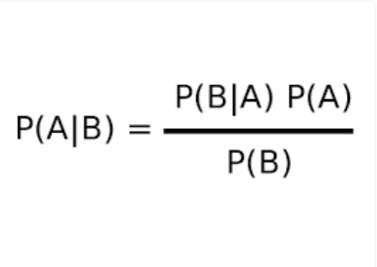
Naive Bayes
Theory
Naive Bayes algorithm is based on Bayes theorem. Bayes theorem gives the conditional probability of an event A given another event B has occurred.
where, P(A|B) = Conditional probability of A given B. P(B|A) = Conditional probability of B given A. P(A) = Probability of event A. P(B) = Probability of event B.

Slide 5
Function
naiveBayes(formula, data,……)
predict(object, newdata, ,……)
install.packages("e1071")
library(e1071)

Slide 6
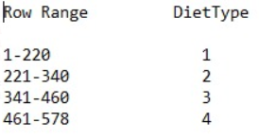
ChickWeight DataSet Division

Slide 7
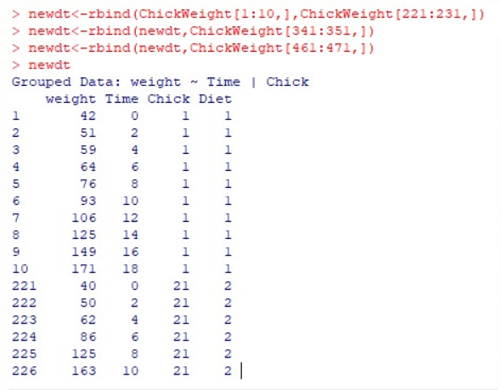
Train Data

Slide 8
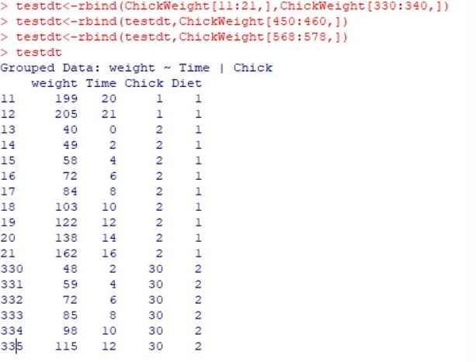
Test Data

Slide 9
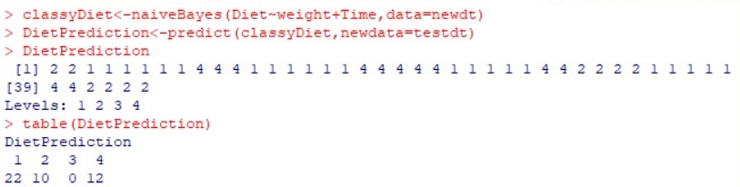
Result

Slide 10
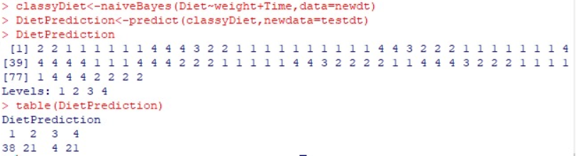
newdt<-rbind(ChickWeight[1:20,],ChickWeight[221:241,])
newdt<-rbind(newdt,ChickWeight[341:361,])
newdt<-rbind(newdt,ChickWeight[461:481,])
testdt<-rbind(ChickWeight[11:31,],ChickWeight[320:340,])
testdt<-rbind(testdt,ChickWeight[440:460,])
testdt<-rbind(testdt,ChickWeight[558:578,])
classyDiet<-naiveBayes(Diet~weight+Time,data=newdt)
DietPrediction<-predict(classyDiet,newdata=testdt)
table(DietPrediction)

Slide 11
Hands On
Using titanic Dataset predict survived which depends on Class, Sex , Age using Naïve Bayes without dividing data.
Hint convert data to dataframe.
Notes:
m <- naiveBayes(Survived ~ ., data = Titanic)
v=predict(m, as.data.frame(Titanic))
table(v)
Using as.data.frame to transform data from multidimensional array into datafra

Slide 12
Thank You

